Slide 1
Cloud Native - Explored
Pravin Y Pawar

Slide 2
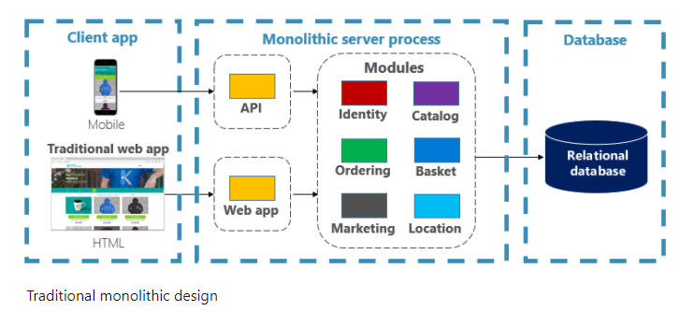
Design “Modern” Web Application
eCommerce App
Required for start-up
Should be cutting edge
You may design
A large core application containing all of domain logic
And modules such as
Identity
Catalog
Ordering
and more
The core app
communicates with a large relational database
exposes functionality via an HTML interface
Source : Microsoft

Slide 3
A monolithic application
Conventional Layered Apps
Distinct advantages:
straightforward to...
build
test
deploy
troubleshoot
scale
Many successful apps that exist today were created as monoliths!
The app is a hit and continues to evolve
iteration after iteration
adding more and more functionality

Slide 4
Monolithic Fear Cycle
At the same time
App become overwhelmingly complicated
You started losing control of the application
Team begin to feel uncomfortable about change in application!
Concerns:
no single person understands it
fear making changes - each change has unintended and costly side effects
new features/fixes become tricky, time-consuming, and expensive to implement
each release requires a full deployment of the entire application
one unstable component can crash the entire system

Slide 5
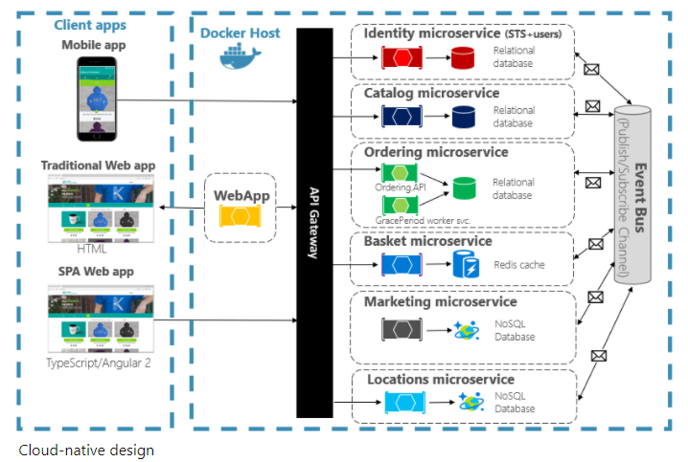
Cloud-native applications
Solution
Source : Microsoft

Slide 6
Cloud-native design
Solution explained
Application is decomposed across a set of small isolated microservices
Each service is
self-contained
encapsulates its own code, data, and dependencies
deployed in a software container
managed by a container orchestrator
owns it own data store - relational, no-sql or cache
API Gateway service
All traffic routes through an API Gateway service that is responsible for
directing traffic to the core back-end services
enforcing many cross-cutting concerns
Application takes full advantage of the
scalability
availability
resiliency
features found in modern cloud platforms

Slide 7
Thank You!
In our next session:

